Slide 1
Hierarchical Latent Models Bi-Factor Models
Examples

Slide 2
First Order WISC
First, let’s fit a first order model for the WISC
If the first order model doesn’t work, then a second order isn’t appropriate
You should also check out the correlations/covariances between factors to make sure that they are even related.

Slide 3
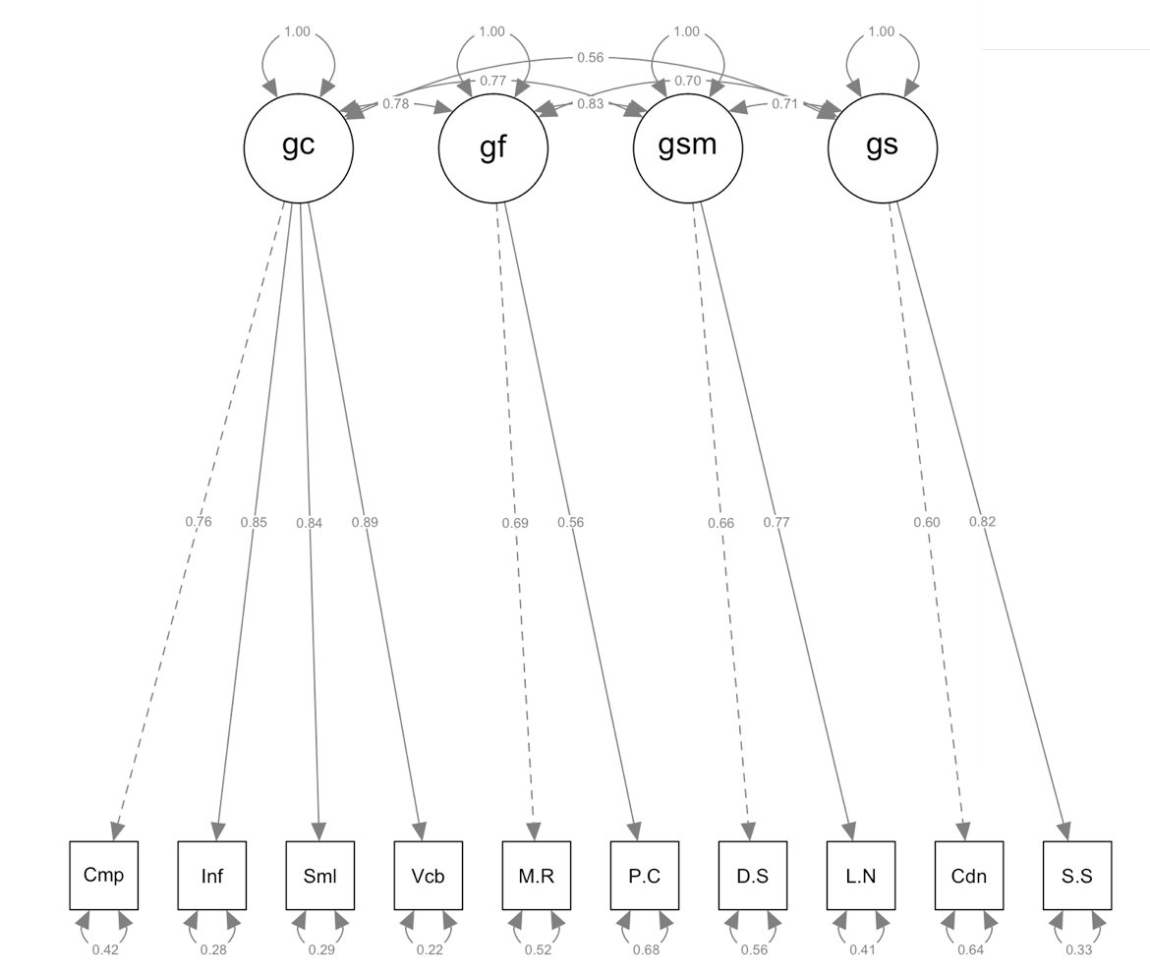
First Order WISC

Slide 4
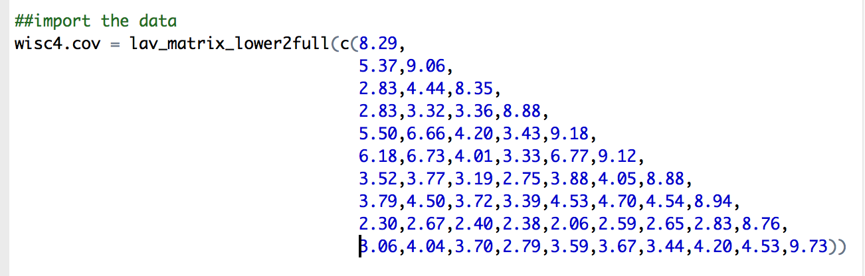
First Order WISC – Import the Data
When using covariance/correlation tables, remember – huge data is easier to see if you stack it.

Slide 5
First Order WISC – Name Everything
In this example, we have the standard deviations, although we don’t need them because we already have covariances.
Use the names, rownames, and colnames functions to name everything.

Slide 6
First Order WISC – Define Model
Remember, with a first order CFA:
You build the latents with LATENT =~ manifest + manifest … etc.
Each latent should be on a separate line.

Slide 7
First Order WISC – Run the Model
Use the cfa function with:
Model name
Sample.cov
Sample.nobs

Slide 8
First Order WISC – Get the Output
Summary:
With fit.measure = T, rsquare = T, standardized = T
Other functions:
parameterestimates(wisc4.fourFactor.fit, standardized=TRUE) ##CIs for parameters
fitted(wisc4.fourFactor.fit) ##look at cov table
residuals(wisc4.fourFactor.fit) ##look at residuals
fitmeasures(wisc4.fourFactor.fit) ##fit indices
modificationindices(wisc4.fourFactor.fit) ##modification indices

Slide 9
First Order WISC – Make a Picture
SemPaths function:
Model fit,
What labels,
layout

Slide 10
First Order WISC – Interpret Output
Heywood cases:
Variances, Rsquares
Parameters
Residuals
Modification Indices
Fit Indices

Slide 11
First Order - WISC
In the first order model, we find that the correlations are pretty high.
That’s a good sign that maybe a second order model is appropriate.
(or that factors should be collapsed, they are not distinct).

Slide 12
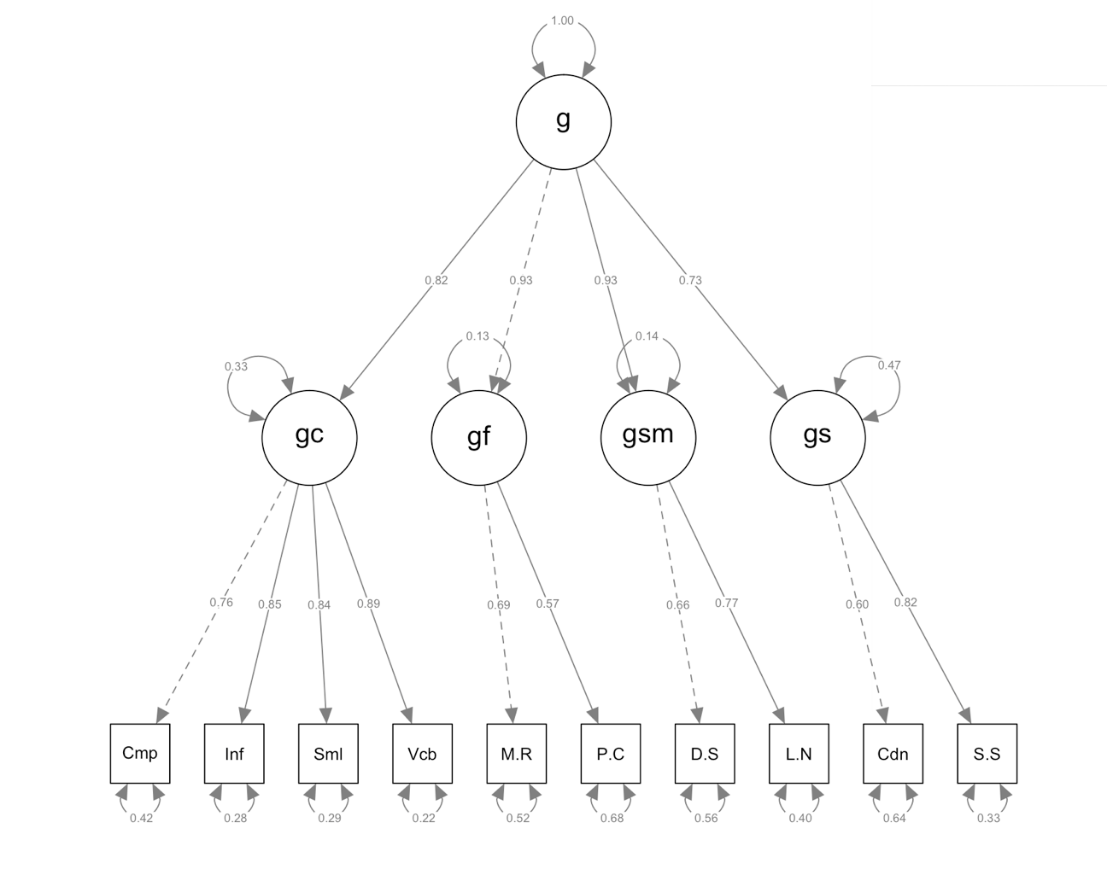
Second-Order WISC

Slide 13
Second-Order WISC – Define Model
Now, let’s try a second order model.
Set the variance of the latent to 1
g=~ NA*gf + gc + gsm + gs ##stops marker variable
g~~ 1*g
OR
Set a path to 1
g=~ gf + gc + gsm + gs

Slide 14
Second-Order WISC – Run and Interpret
Running model is exactly the same, as well as drawing and getting output.
Interpret:
Heywood cases:
Variances, Rsquares
Parameters **
Residuals
Modification Indices
Fit Indices

Slide 15
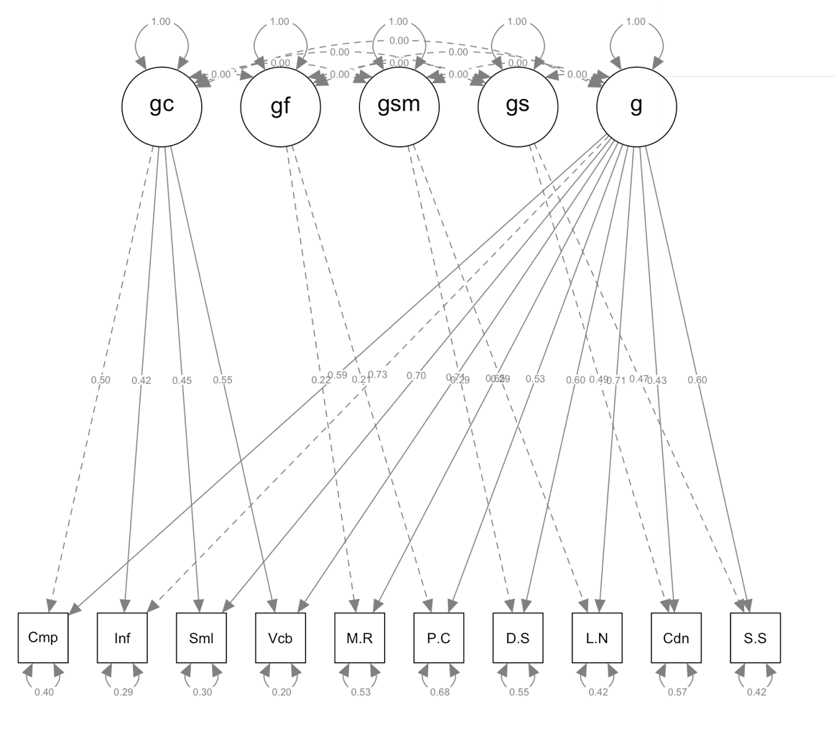
Bi-factor WISC

Slide 16
Bi-factor WISC – Define Model
Bi-factor model
What does this code do?
gf =~ a*Matrix.Reasoning + a*Picture.Concepts
gsm =~ b*Digit.Span + b*Letter.Number
gs =~ c*Coding + c*Symbol.Searc
In this particular model, because we have only two indicators, we have to set them equal for identification for a bifactor … why not the regular one?

Slide 17
Bi-factor WISC – Define Model
After you define one set of latents (the normal CFA):
Add a second latent that every variable is related to:
g =~ Information + Comprehension + Matrix.Reasoning + Picture.Concepts + Similarities + Vocabulary + Digit.Span + Letter.Number + Coding + Symbol.Search

Slide 18
Bi-factor WISC – Run Model
Add this orthogonal code to your cfa function
orthogonal=TRUE
Forces the latents to be uncorrelated, which is faster than turning each path off individually

Slide 19
Bi-factor WISC – Run and Interpret
The next steps are the same as above with the other CFAs.
Interpret:
Heywood cases:
Variances, Rsquares
Parameters **
Residuals
Modification Indices
Fit Indices

